Slide 1
MAESTRO Workshop #2
The Incidental Catch Model
Using Life History & Fishery Removals to (re)construct population dynamic trends
Sub project 4.2
David Keith, Heather Bowlby, Freya Keyser and
Julie Charbonneau

Slide 2
Goals – Data – Methods – Results – Discussion
Scientific questions
Q1 : What is the current spatial distribution of communities (taxonomically and functionally)?
Q2 : Have there been changes in distributions in the last 20 years?
Q3 : Which factors (environmental and fisheries) influence these spatiotemporal dynamics?

Slide 3
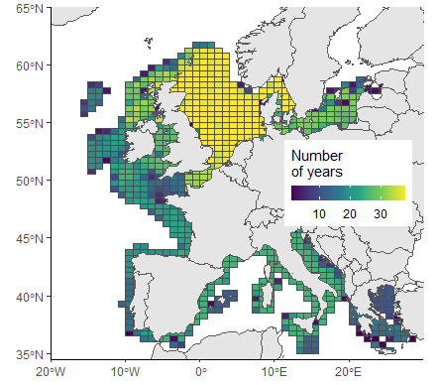
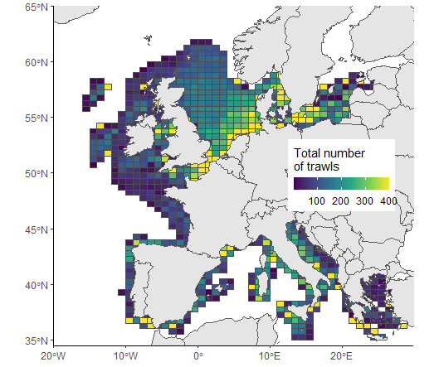
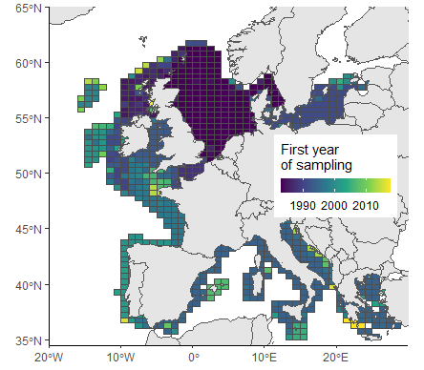
Goals – Data – Methods – Results – Discussion
Data bias : yearly

Slide 4
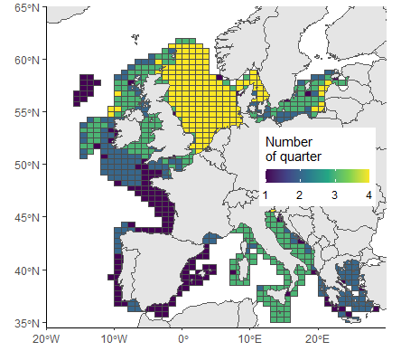
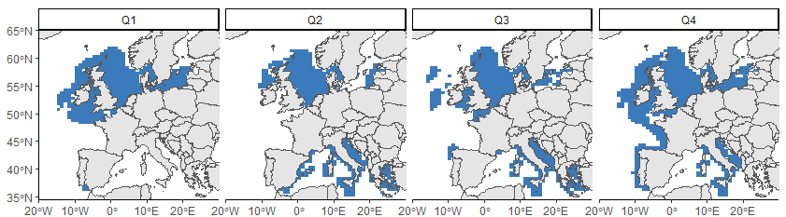
Goals – Data – Methods – Results – Discussion
Data bias : seasonally

Slide 5
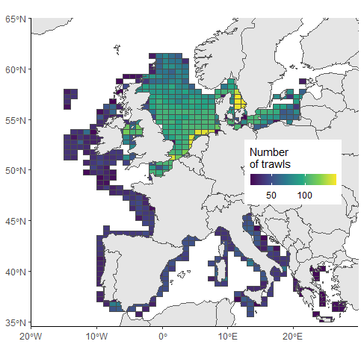
Goals – Data – Methods – Results – Discussion
Data bias : new sampling
107,954 trawls
Years after 1994 and until 2019
ICES rectangle with the first year of sampling before 2005
ICES rectangle with at least 10 years sampled
At least 2 trawls by ICES rectangle, year and quarter
Randomly sample two trawls in each ICES rectangle, by year and quarter
32,566 trawls
Notes:
None criterion of quarter because too complicated

Slide 6
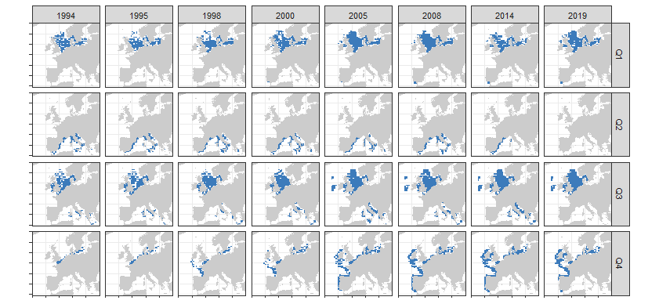
Goals – Data – Methods – Results – Discussion
Data bias : new sampling

Slide 7
Goals – Data – Methods – Results – Discussion
Taxonomy and functional in parallel, with the two following approaches :
Diversity metrics calculation (e.g. Shannon) by trawl,
Maps of the metrics,
Spatiotemporal statistical models function of external variables (environment and fishing).
Space analyses (e.g. PCA and PCoA),
Spatial and temporal of first dimensions,
Projection of external variables to measure their influence.

Slide 8
Goals – Data – Methods – Results – Discussion
First method : Space analyses
570 species
Taxonomy
32,566 trawls
Abundances
Hellinger transformation
PCA
Maps and plots of the 5 first dimensions

Slide 9
Goals – Data – Methods – Results – Discussion
First method : Space analyses
570 species
Taxonomy
32,566 trawls
Abundances
Hellinger transformation
PCA
Maps and plots of the 5 first dimensions
Functional
570 species
Length infinity, Length maturity, Age maturity,
K growth,
Trophic level,
Spawning type,
Vertical habitat,
Diet
11 traits
Functional space for
the species
(PCoA, mfD package)

Slide 10
Goals – Data – Methods – Results – Discussion
First method : Space analyses
570 species
Taxonomy
32,566 trawls
Abundances
Hellinger transformation
PCA
Maps and plots of the 5 first dimensions
Functional
570 species
570 species
Length infinity, Length maturity, Age maturity,
K growth,
Trophic level,
Spawning type,
Vertical habitat,
Diet
32,566 trawls
Abundances
5 dimensions
11 traits
Weighted mean
Maps and plots of the first dimensions
32,566 trawls
Centroid coordinates
Functional space for
the species
(PCoA, mfD package)

Slide 11
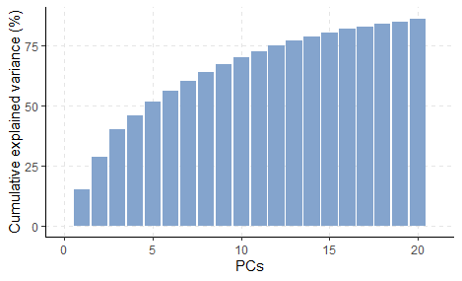
Goals – Data – Methods – Results – Discussion
Taxonomy

Slide 12
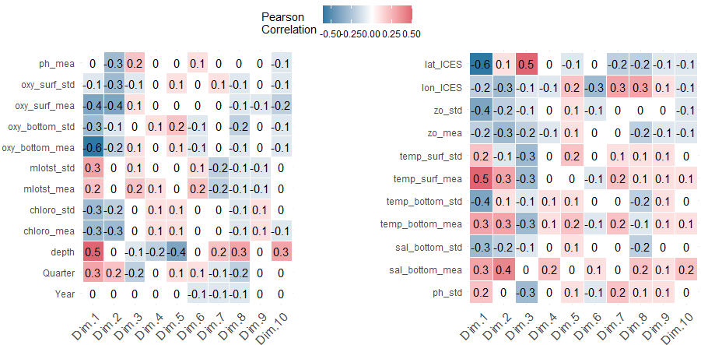
Goals – Data – Methods – Results – Discussion
Taxonomy

Slide 13
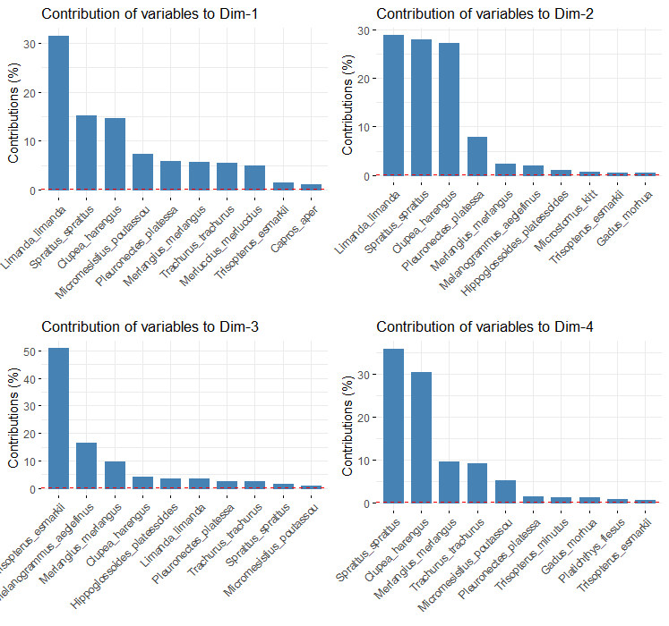
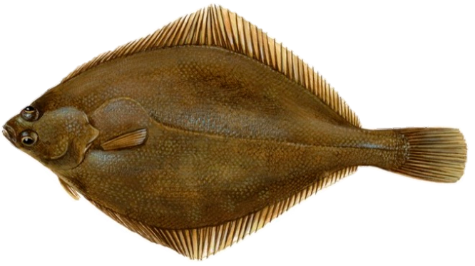
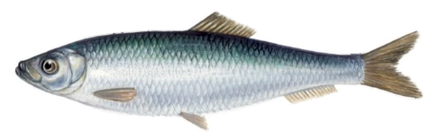
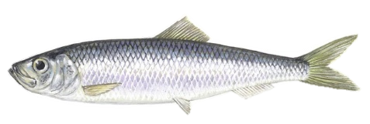
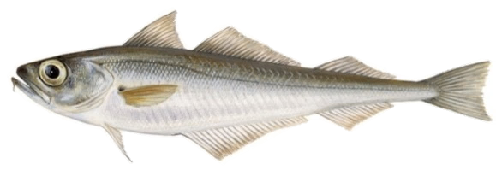
Goals – Data – Methods – Results – Discussion
Taxonomy
Limande
Dab
Limanda limanda
Sprat
Sprattus sprattus
Hareng
Herring
Clupea harengus
Tacaud
Norway pout
Trisopterus esmarkii

Slide 14
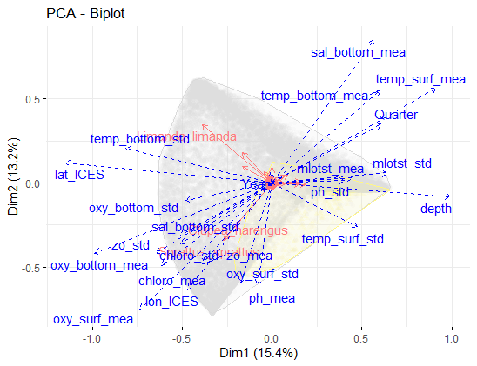
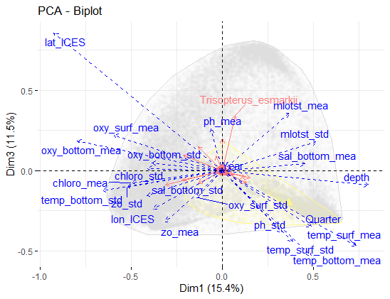
Goals – Data – Methods – Results – Discussion
Taxonomy

Slide 15
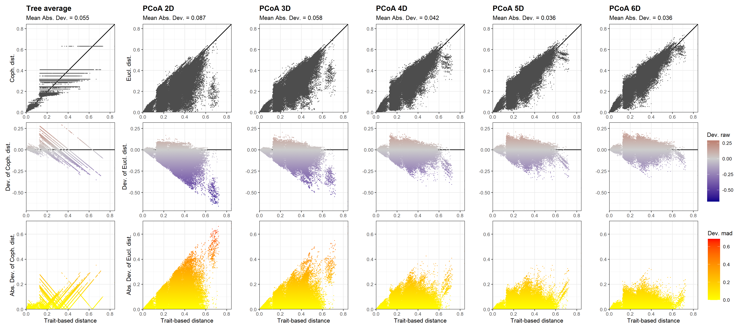
Goals – Data – Methods – Results – Discussion
Functional

Slide 16
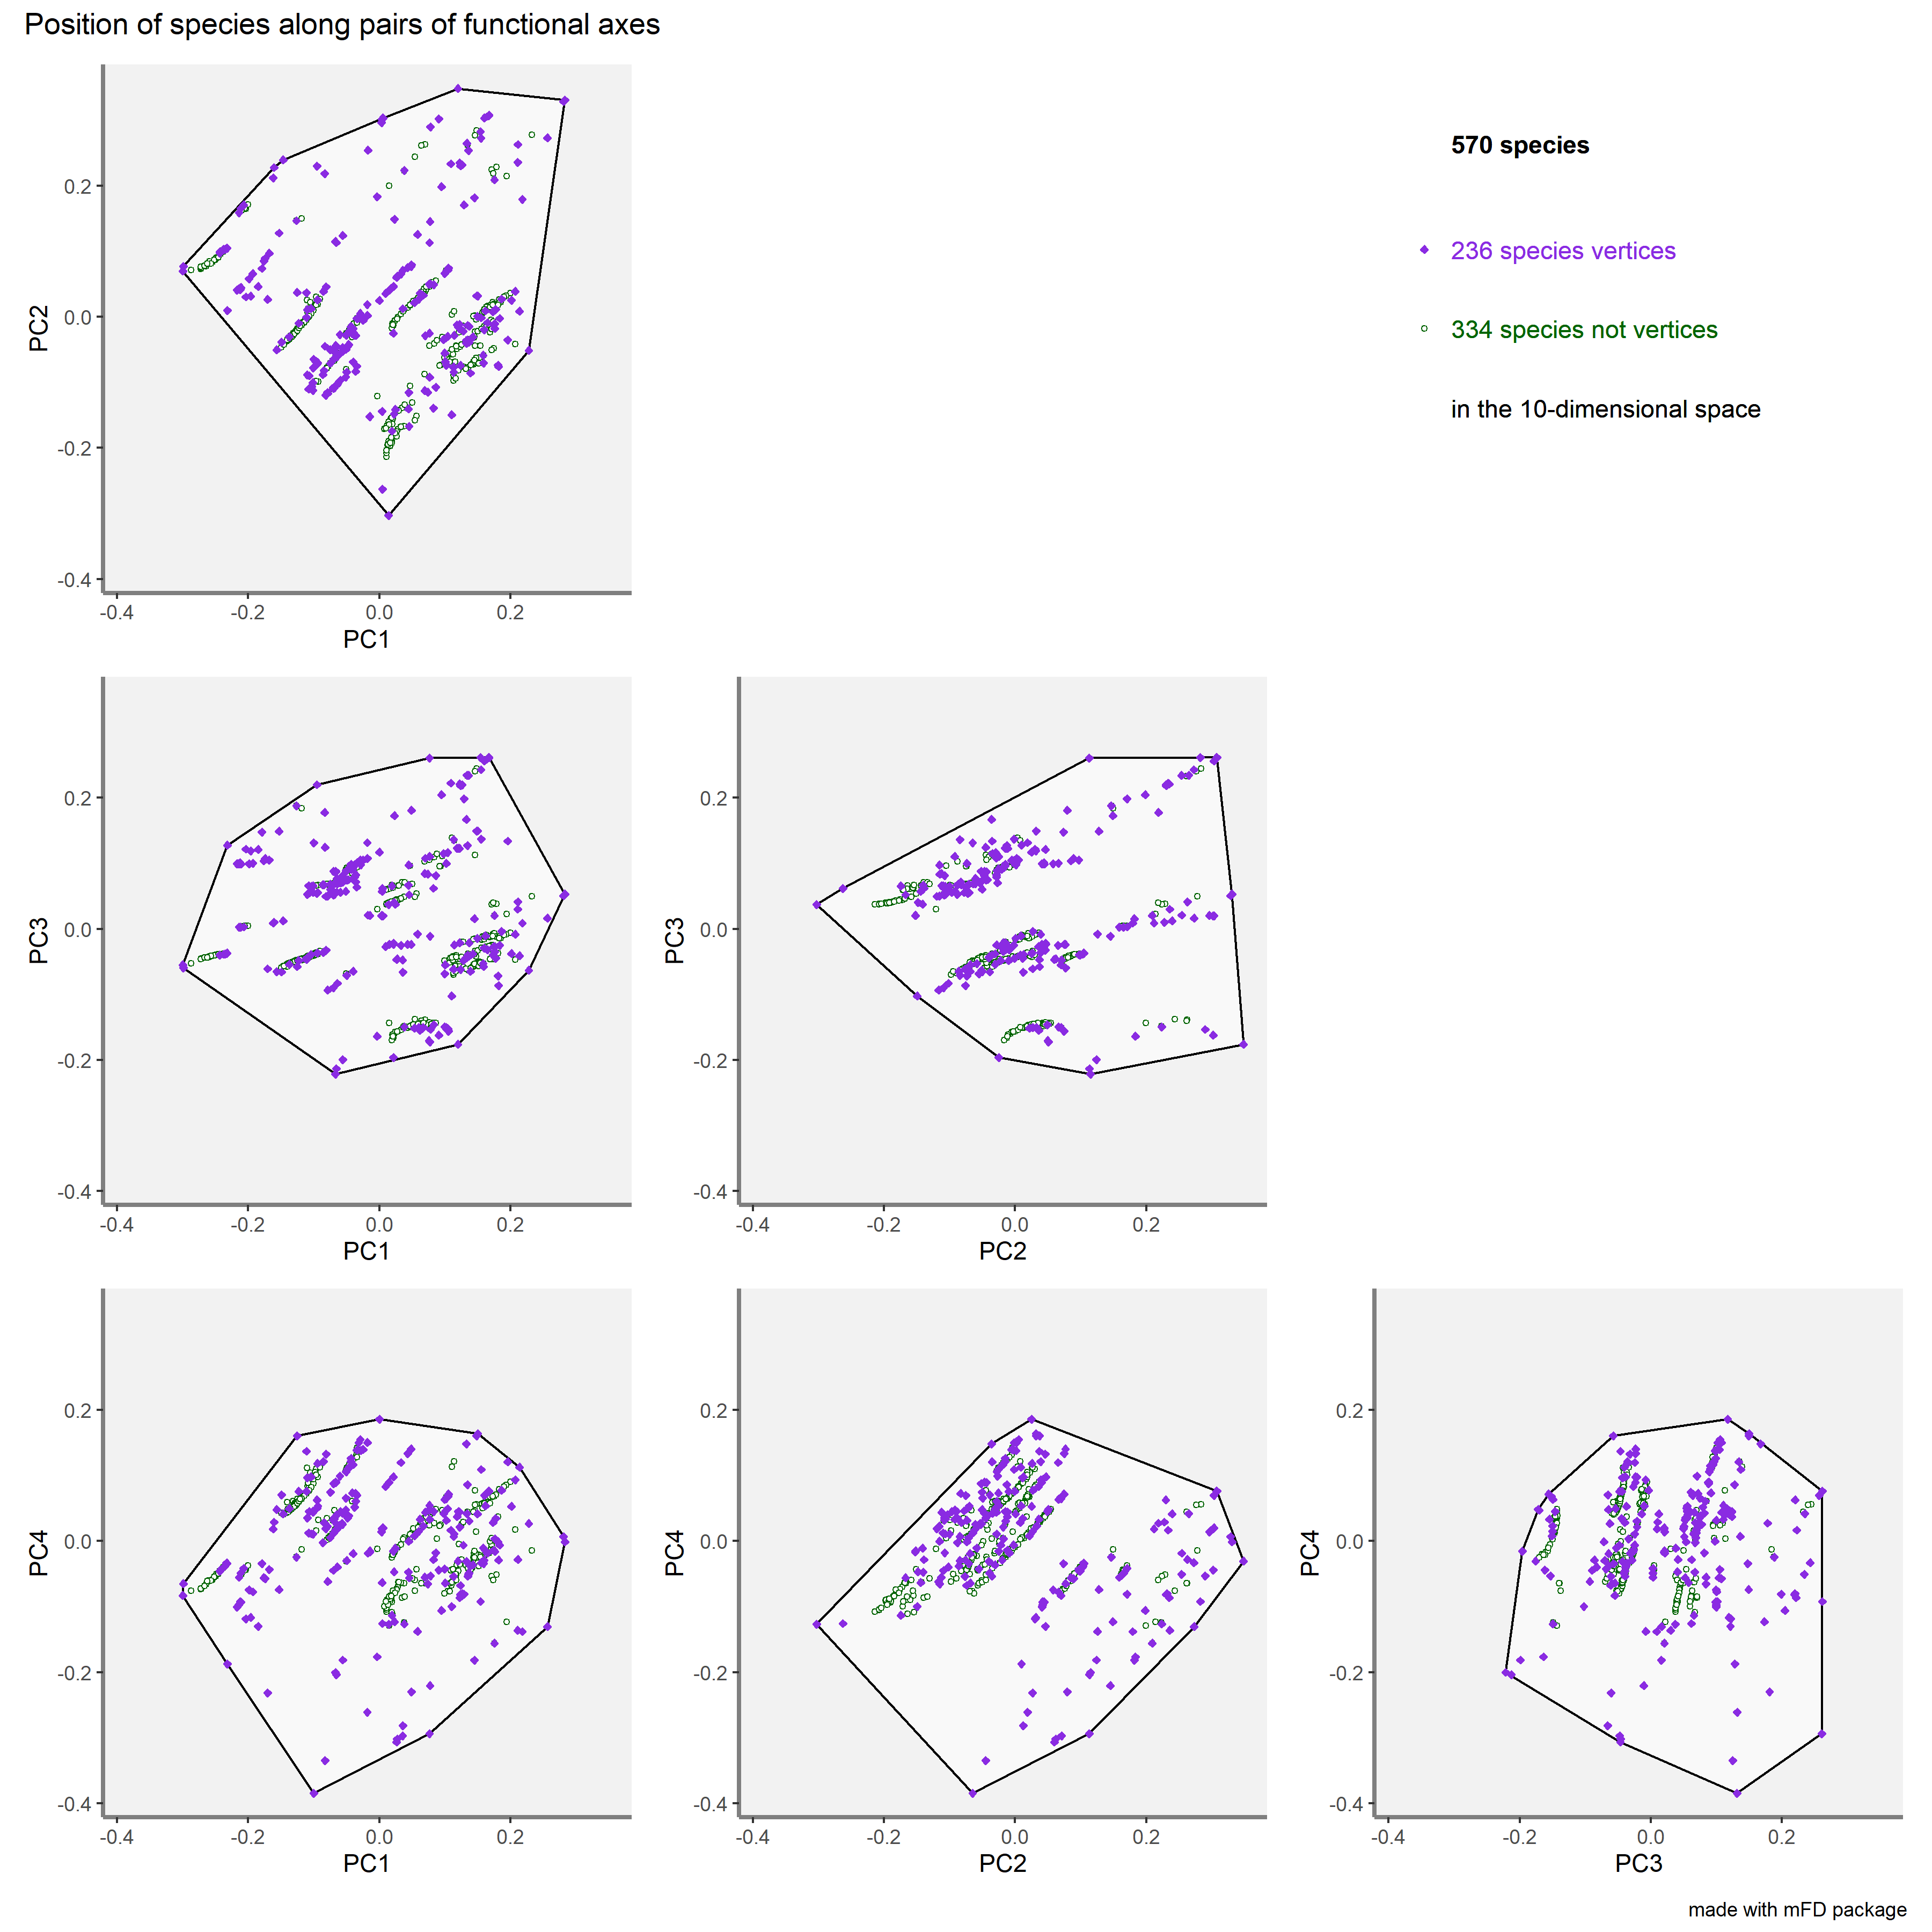
Goals – Data – Methods – Results – Discussion
Functional

Slide 17
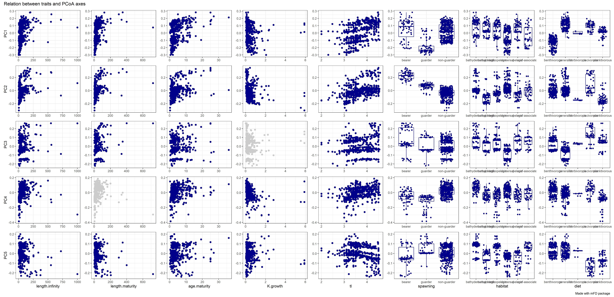
Goals – Data – Methods – Results – Discussion
Functional
Infinity length
Maturity length
Maturity age
K growth
Trophic level
Spawning type
Habitat
Diet

Slide 18
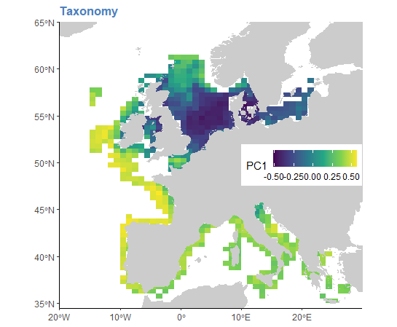
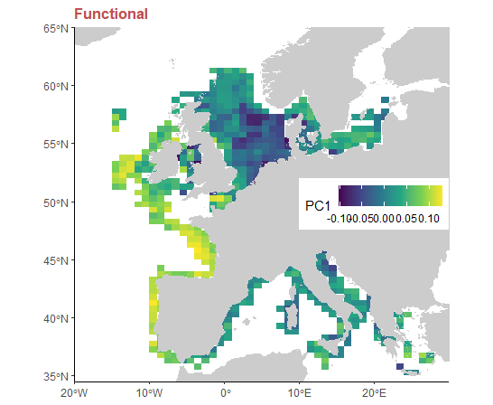
Goals – Data – Methods – Results – Discussion
Taxonomy
Functional

Slide 19
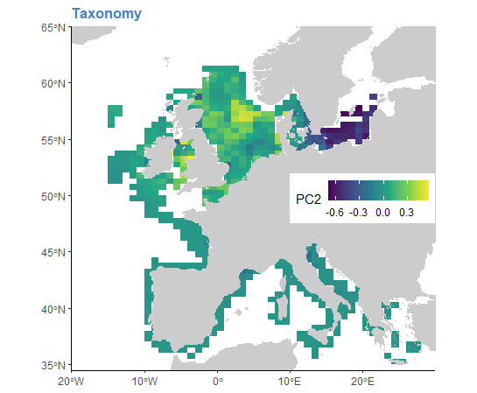
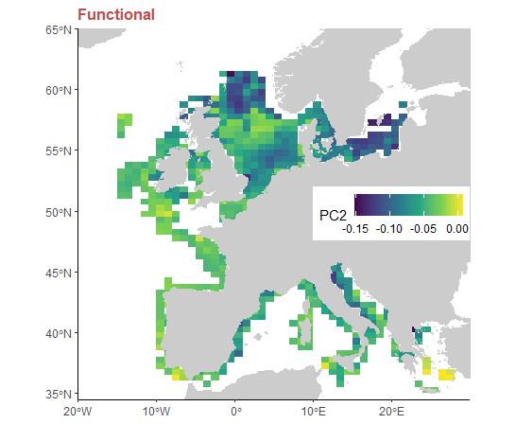
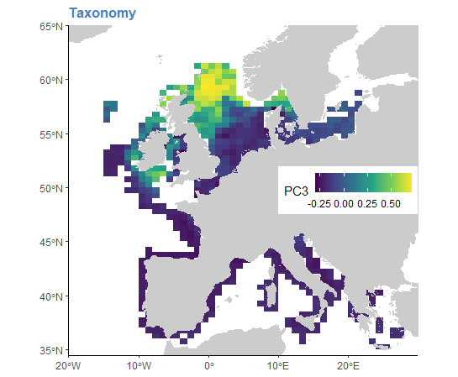
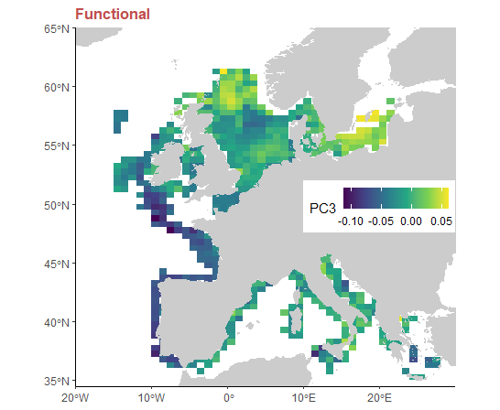
Goals – Data – Methods – Results – Discussion
Taxonomy
Functional

Slide 20
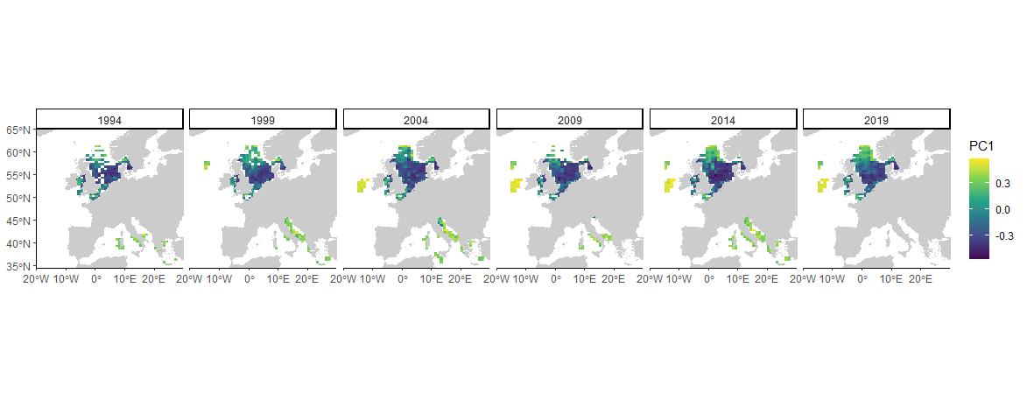
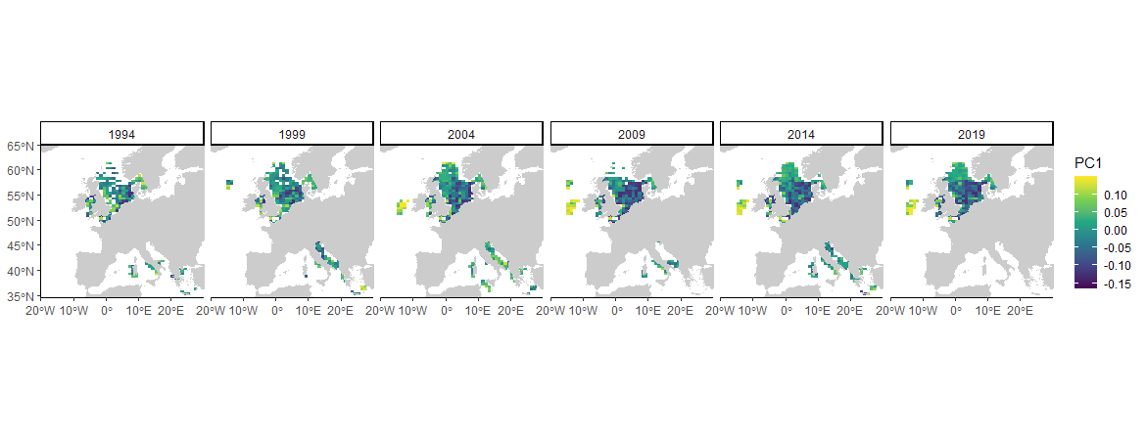
Goals – Data – Methods – Results – Discussion
Taxonomy
Functional

Slide 21
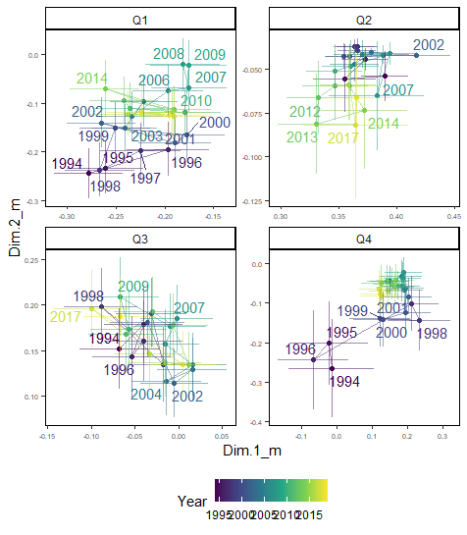
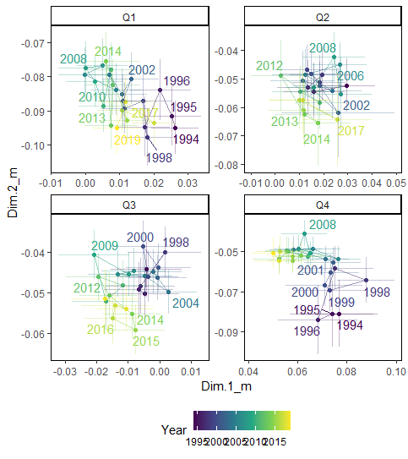
Goals – Data – Methods – Results – Discussion
Taxonomy
Functional

Slide 22
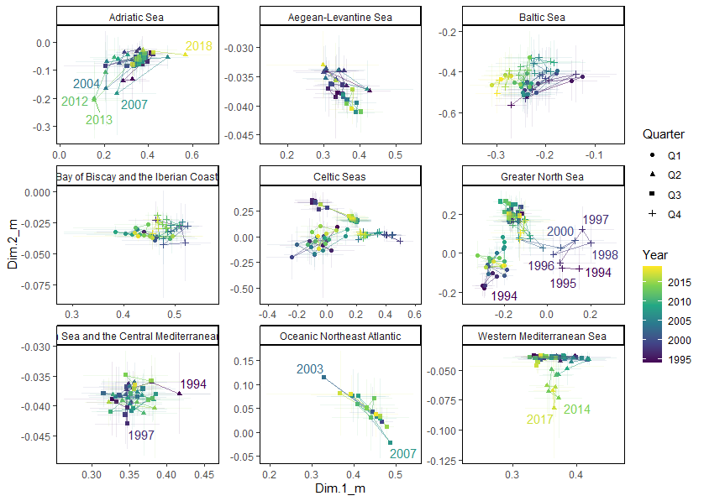
Goals – Data – Methods – Results – Discussion
Functional
Taxonomy

Slide 23
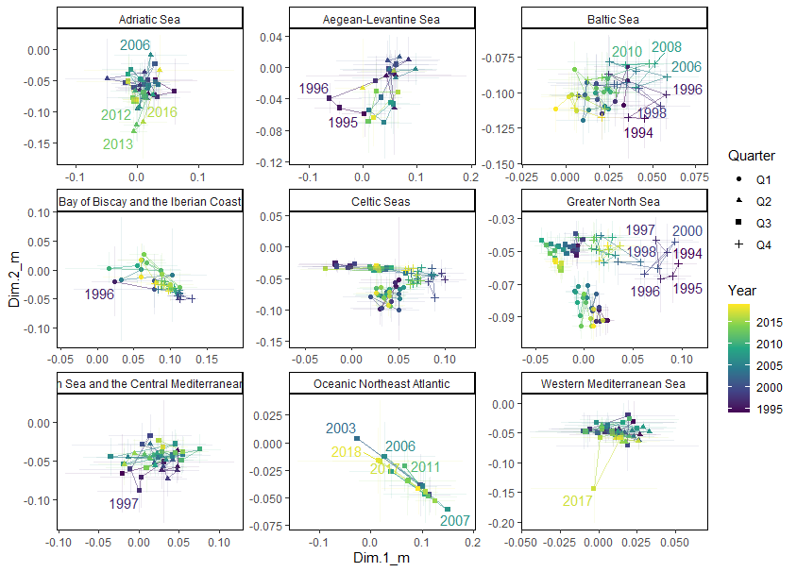
Goals – Data – Methods – Results – Discussion
Taxonomy
Functional
Functional

Slide 24
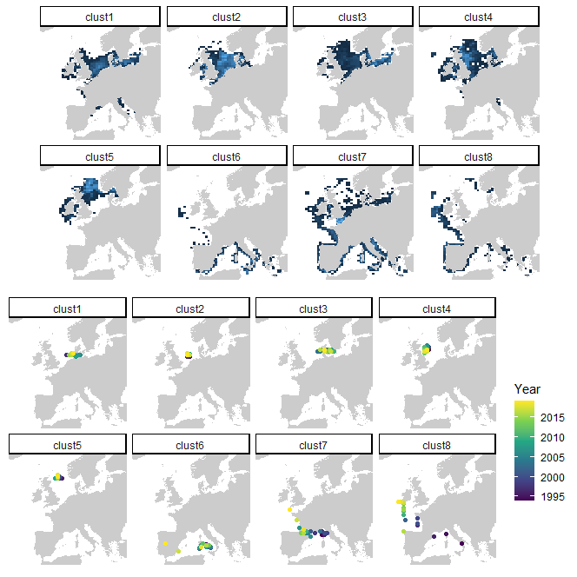
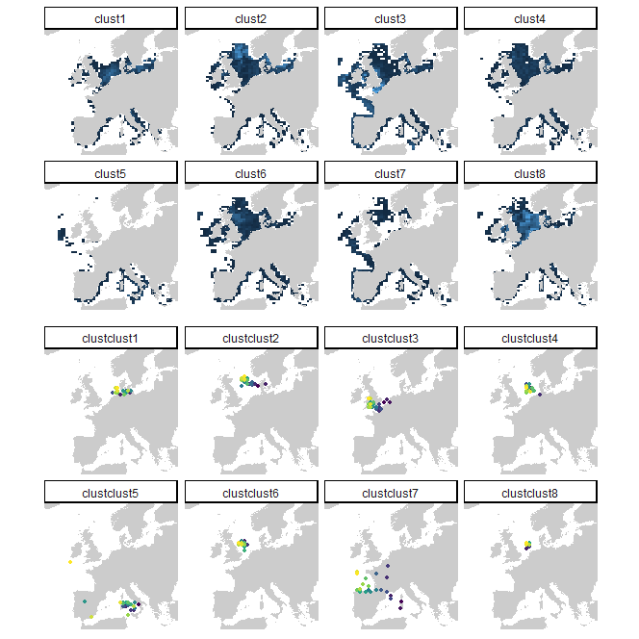
Goals – Data – Methods – Results – Discussion
Taxonomy
Functional

Slide 25
Goals – Data – Methods – Results – Discussion
Taxonomy
Functional

Slide 26
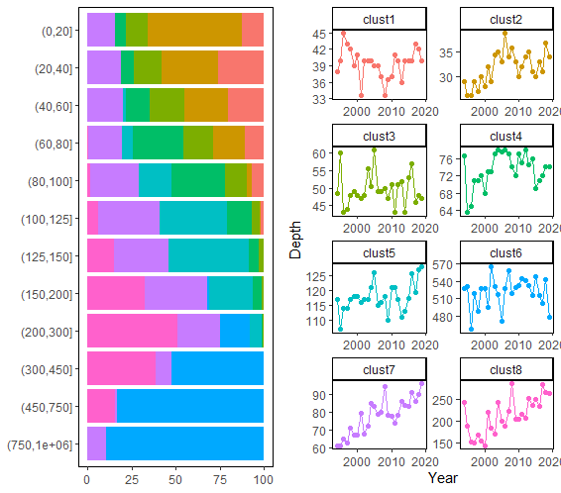
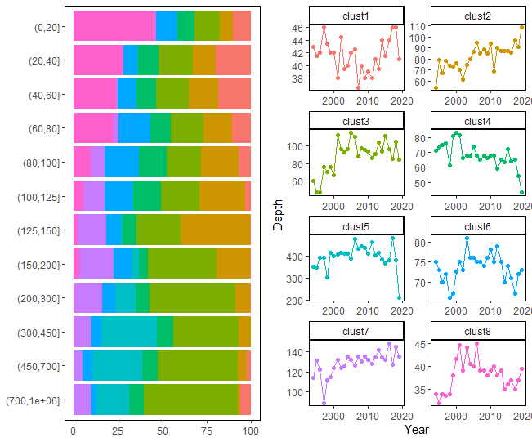
Goals – Data – Methods – Results – Discussion
Taxonomy
Functional

Slide 27
Goals – Data – Methods – Results – Discussion
Taxonomy
Functional

Slide 28
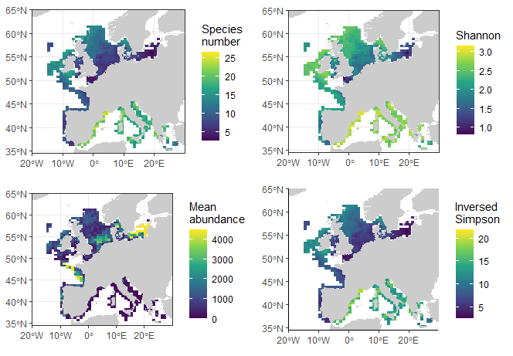
Goals – Data – Methods – Results – Discussion
Diversity metrics
Taxonomy

Slide 29
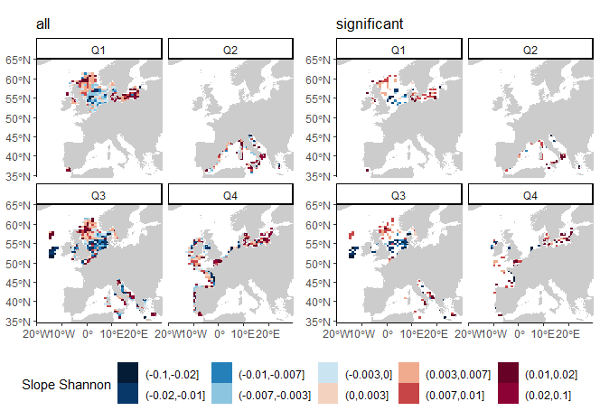
Goals – Data – Methods – Results – Discussion
Diversity metrics
Taxonomy
Shannon

Slide 30
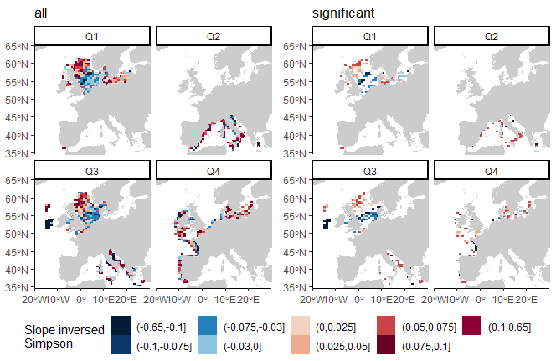
Goals – Data – Methods – Results – Discussion
Diversity metrics
Taxonomy
Inversed Simpson

Slide 31
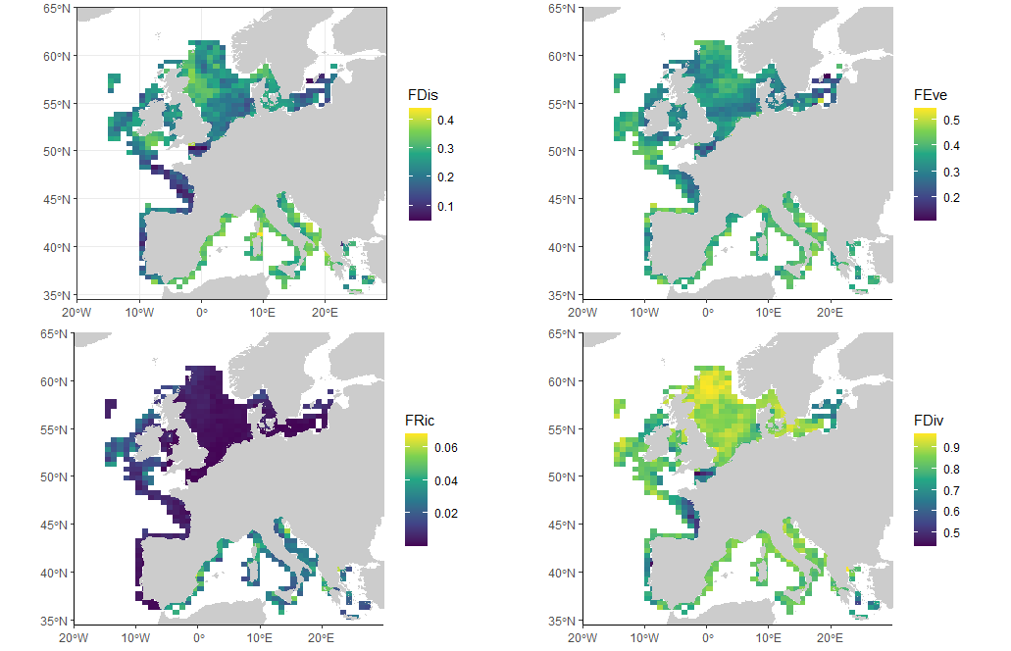
Goals – Data – Methods – Results – Discussion
Diversity metrics
Functional
Evenness (regularity)
Dispersion
Richness
Divergence

Slide 32
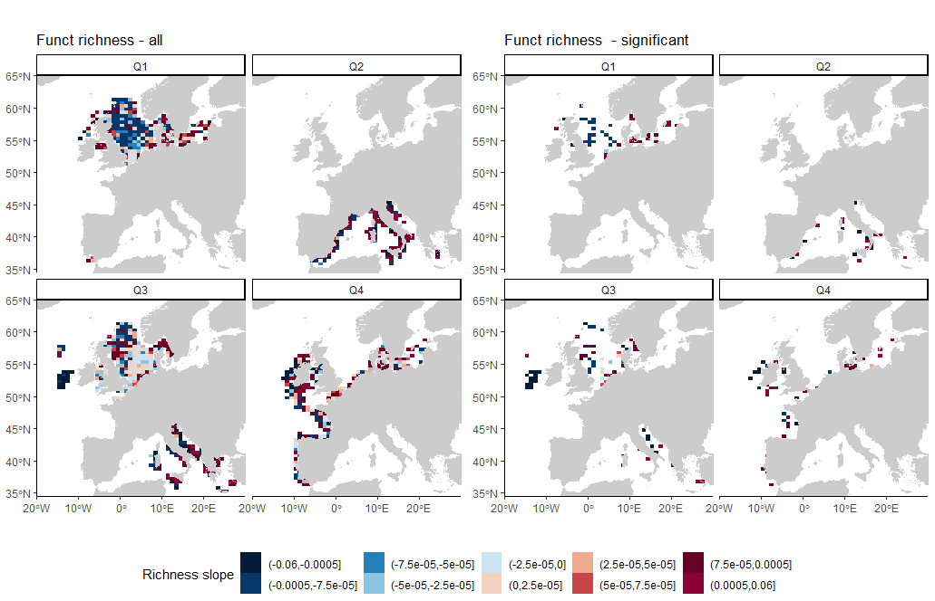
Goals – Data – Methods – Results – Discussion
Diversity metrics
Functional
Richness

Slide 33
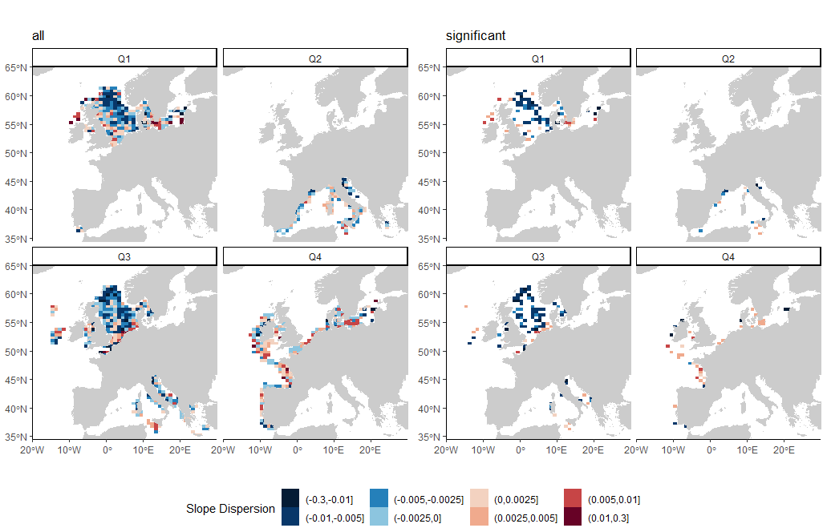
Goals – Data – Methods – Results – Discussion
Diversity metrics
Functional
Dispersion

Slide 34
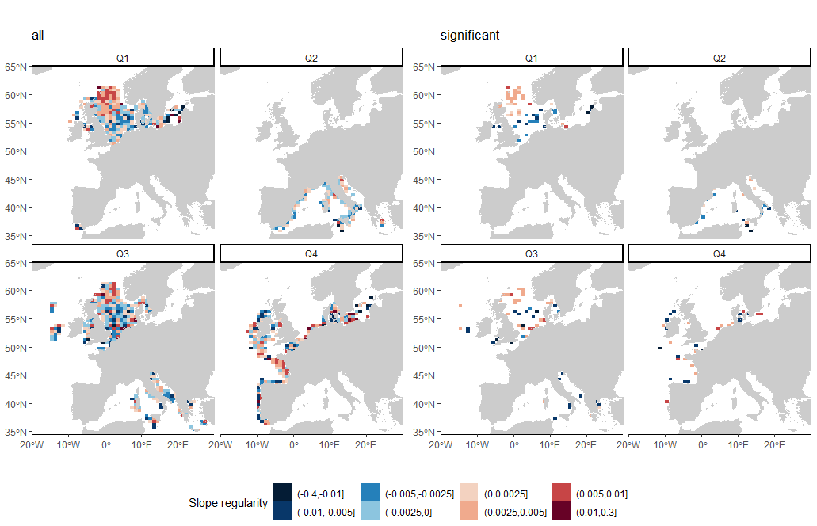
Goals – Data – Methods – Results – Discussion
Diversity metrics
Functional
Evenness (regularity)

Slide 35
Goals – Data – Methods – Results – Discussion
Summary
Very strong spatial structure both in taxonomic and functional,
Temporal evolution smaller, especially found in the North Sea,
Seasonal variability almost null in the Mediterranean Sea, and very strong in the North Sea,
Mediterranean Sea more similar to the North Sea in terms of function, compared to the Bay of Biscay,
Sea bottom depth, surface temperature and bottom oxygen seem to structure the communities,
Increased taxonomic diversity in the northern part of the North sea, Baltic Sea and western Mediterranean but become more homogenous
Decrease of the function richness and dispersion in the north sea, but increase in the Mediterranean
Increase of the functional regularity in the northern part of the north sea

Slide 36
Goals – Data – Methods – Results – Discussion
What’s next ?
Describe by writing all the evolution showed
Better link functional and diversity metrics
Work on external drivers (environmental and fisheries)
-> which fisheries data ? (GFW, European data, other ideas?)
Start writing a shared document

